Slide 1
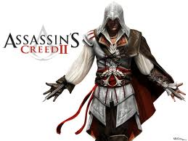
Assassins
Creed II
Review

Slide 2
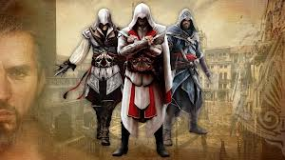
Story rating
Characters=4/5
Story structure=4/5
Language feachers5/5=16/20 this story was excellent
Theme=3/5

Slide 3
Review
Ezio was a normal kid until his father was betrayed by the ruling families of Italy and killed. That day Ezio swore he would have revenge, so he became an assassin. He met a lady called Pola that trained him to become an assassin and Leonardo Di Vinchi helped with all the weaponry. Finally when he kills the royal families be becomes the most wanted man in Italy what will he do ? Read to find out.

Slide 4
Characters
Ezio, Pola, and Leonardo Di Vinchi are the main characters. They are all well developed and they are all very interesting. Ezio and Pola are assassins and Leonardo Di Vinchi is a craftsman and they all match the setting very well.

Slide 5
Story Structure
The story structure was good it had a solid problem and a good solution. Overall it was really good

Slide 6
Language features
There was some very hard words to understand but it’s good because it has a glossary.

Slide 7
Theme
The story didn’t have a theme as such but I know one. It isn’t as easy to kill someone.
Overall this book was very interesting.

Slide 8
Buy and read assassins creed today

